Slide 1


Machine Learning
Naïve Bayes & Bayesian Learning

Slide 2
Table of Content
Introduction to Naïve
What is Bayesian Learning
Mathematics concept
Research Paper Review

Slide 3
Introduction to Naïve Bayes
Naive Bayes is a probabilistic machine learning algorithm based on the Bayes Theorem, used in a wide variety of classification tasks
Naive Bayes is a probabilistic machine learning algorithm that can be used in a wide variety of classification tasks
why is it called ‘Naive’?
The name naive is used because it assumes the features that go into the model is independent of each other
That is changing the value of one feature, does not directly influence or change the value of any of the other features used in the algorithm

Slide 4
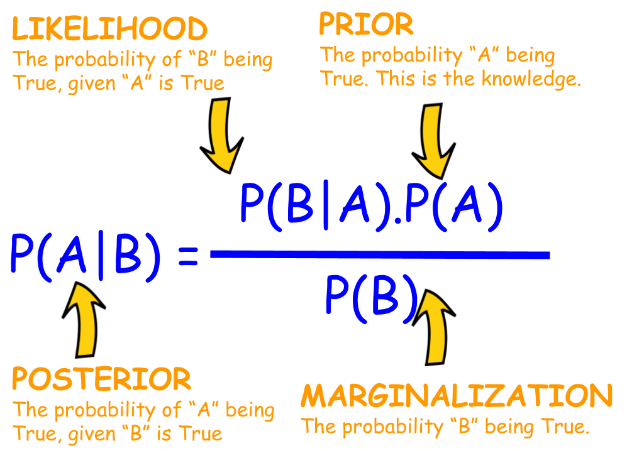
Introduction to Naïve Bayes
Bayes Rule
Bayes’ Theorem finds the probability of an event occurring given the probability of another event that has already occurred

Slide 5
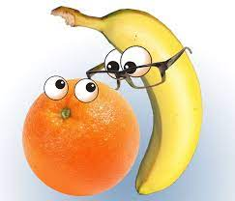
Introduction to Naïve Bayes Example
Say you have 1000 fruits which could be either ‘banana’, ‘orange’ or ‘other’. These are the 3 possible classes of the Y variable.
We have data for the following X variables, all of which are binary (1 or 0).
Long
Sweet
Yellow

Slide 6
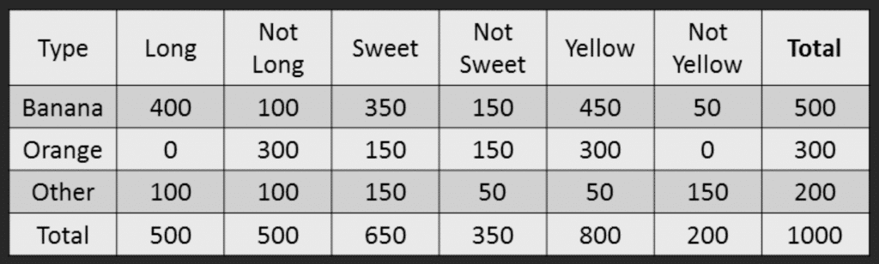
Introduction to Naïve Bayes Example

Slide 7
Introduction to Naïve Bayes Example
Step 1: Compute the ‘Prior’ probabilities for each of the class of fruits.
For this case, let’s compute from the training data. Out of 1000 records in training data, you have 500 Bananas, 300 Oranges and 200 Others. So the respective priors are 0.5, 0.3 and 0.2.
P(Y=Banana) = 500 / 1000 = 0.50
P(Y=Orange) = 300 / 1000 = 0.30
P(Y=Other) = 200 / 1000 = 0.20

Slide 8
Introduction to Naïve Bayes Example
Compute
Compute the probability of evidence that goes in the denominator.
P(x1=Long) = 500 / 1000 = 0.50
P(x2=Sweet) = 650 / 1000 = 0.65
P(x3=Yellow) = 800 / 1000 = 0.80
Compute
Compute the probability of likelihood of evidences that goes in the numerator
Probability of Likelihood for Banana
P(x1=Long | Y=Banana) = 400 / 500 = 0.80
P(x2=Sweet | Y=Banana) = 350 / 500 = 0.70
P(x3=Yellow | Y=Banana) = 450 / 500 = 0.90

Slide 9
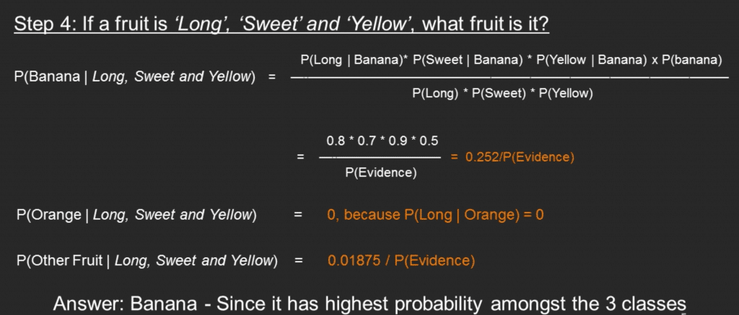

Slide 10
What is Bayesian Learning
Bayesian learning uses Bayes' theorem to determine the conditional probability of a hypotheses given some evidence or observations
Naive Bayes learning refers to the construction of a Bayesian probabilistic model that assigns a posterior class probability to an instance: P(Y = yj | X = xi).

Slide 11
Mathematics concept
Bayesian Classifiers
Consider each attribute and class label as random variables
Given a record with attributes (A1, A2,...,An)
Goal is to predict class C
Specifically, we want to find the value of C that maximizes P(C| A1, A2,...,An )
Can we estimate P(C| A1, A2,...,An ) directly from data?

Slide 12
Mathematics concept
Approach:
compute the posterior probability P(C | A1, A2, ..., An) for all
values of C using the Bayes theorem
Choose value of C that maximizes(C | A1, A2, ..., An)
Equivalent to choosing value of C that maximizes(A1, A2, ..., An|C) P(C)
How to estimate P(A1, A2, ..., An | C )?

Slide 13
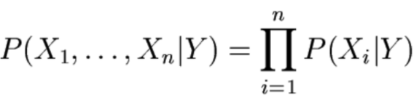
Mathematics concept Naïve Bayes Classifier & model
Assume independence among attributes Ai when class is given P(A1, A2, ..., An |C) = P(A1| Cj) P(A2| Cj)... P(An| Cj)
Can estimate P(Ai| Cj) for all Ai and Cj
New point is classified to Cj if P(Cj) P P(Ai| Cj) is maximum.

Slide 14
Research Paper Review Litatute Review
Title | Email Spam Detection using Naive Bayes Classifier
Author | Megha Tope
Year | 2018
Abstraction | World wide web is expanding and spreading every day. Email seems to be a reliable form of communication and is the fastest way to send information. In addition to their advantages, e-mail has also been affected by spam attacks. Spam will flood the Internet with many in-depth copies of the messages. Analyzing data mining methods for spam data for email sorting.
Keywords | E-mail spam, Classification, Feature Extraction, Naïve Bayesian Classifier

Slide 15
Research Paper Review Litatute Review
Steps of proposed method | Pre-processing Message tokenization Probability estimation Feature extraction Naïve Bayesian classifier Spam or Legitimate classification
Findings | The naive Bayesian classifier classifies most of the word accurately The Bayesian naive classifier produces a better result compared to the vector machine. The classifiers work well when we incorporate the feature selection approach into the classification process.
Reference | https://www.ijsdr.org/papers/IJSDR1906001.pdf Masurah Mohammad, Ali Selman An Evaluation on the Efficiency of Hybrid Feature Selection in Spam Email Classification, IEEE,2015 C. Bala Kumar, D. Ganesh Kumar A Data Mining Approach on Various Classifiers in Email Spam Filtering, IJRASET, May 2015

Slide 16
Research Paper Review Problem statement briefing
In the classification of spam, the main source of concern is the classification of e-mail and unwanted threats. So today, most researchers are working in this area to find the best classifier to detect spam. Therefore, you need a filter with great precision to filter out spam mails or spam mails. This article, focused on finding the spam classification using Naïve bayes classifier .
The Naïve Bayes Classifier extract the word using the word count algorithm. The error rate is very low when we use the Bayesian Naïve Classifier. It can be said that Naïve Bayesian Classifier produces a better result than Support Vector Machine

Slide 17
Research Paper Review ML model implementation
Select the email
Extract features with help of tokenization and word count algorithm.
Training the dataset with the help of Naive Bayesian Classifier.
Find the probability of spam and non-spam mails.
Testing the dataset then document are spam else the document are non-spam
Classify the spam and non-spam mails.
Compute the error of the text data and calculate the word which is wrongly classified
Display the error rate of text data and calculate the fraction of wrongly classified word

Slide 18
Performance Enhancement Evalution of Research Paper
The naive Bayesian classifier classifies most of the word accurately.
When the number of data sets is increased, the Bayesian naive classifier produces a better result compared to the vector machine.
Therefore a large dataset for training will produce a better accuracy of model

Slide 19
Performance Enhancement
The Scikit-Learn machine learning library provides tools for tuning model hyperparameters.
Specifically, it provides the GridSearchCV and RandomizedSearchCV classes that take a model, a search space, and a cross-validation configuration.
The benefit of these classes is that the search procedure is performed automatically, requiring minimal configuration.
Similarly, the Scikit-Optimize library provides a similar interface for performing a Bayesian Optimization of model hyperparameters via the BayesSearchCV class.
This class can be used in the same way as the Scikit-Learn equivalents.

Slide 20
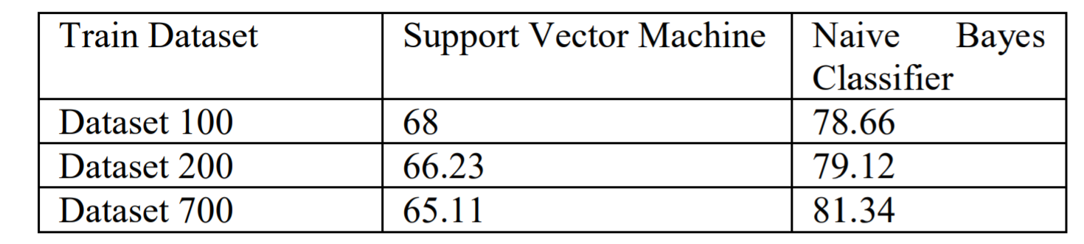
Research Paper Review Results
This Paper present reading for the four sets of data formed that are tested by the classifier, i.e. naive Bayesian Classifier and Support Vector Machine. Hence the different readings and calculation of the result:

Slide 21
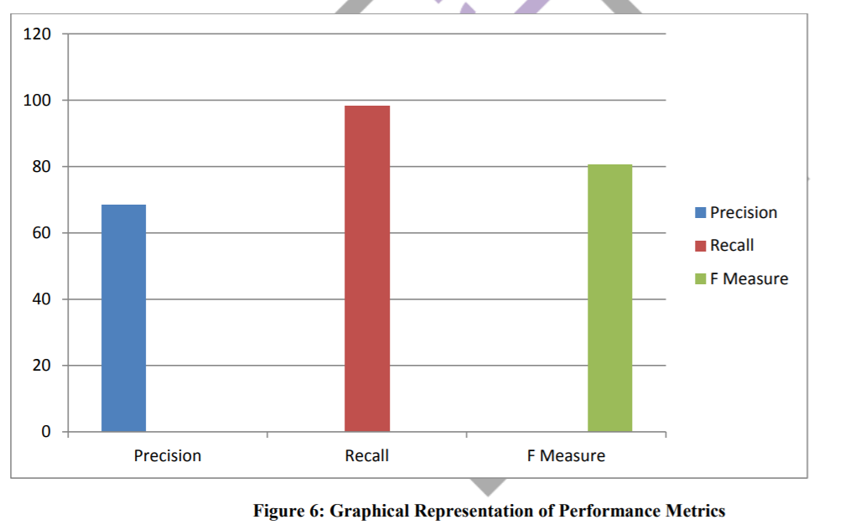
Research Paper Review Results
This reading contains the text data classified by the classifier and provides the word that is misclassified and the classifier error rate.
Therefore, we can show the overall result provided by the classifier. And to say that the naive Bayesian classifier classifies most of the word accurately.
When the number of data sets is increased, the Bayesian naive classifier produces a better result compared to the vector machine.

Slide 22
References
https://scikit-learn.org/stable/modules/naive_bayes.html
https://www.geeksforgeeks.org/naive-bayes-classifiers/
https://www.ijsdr.org/papers/IJSDR1906001.pdf

